Slide 1
Data powered mobility by ERTICO Partnership
ertico.com I @ertico

Slide 2
Panel 3: The Cyber-Secure Infrastructure
Live Broadcast: Thursday, June 03, 2020, 02:00 PM CEST (8am EST)
Moderator: Jeffrey Davis, Senior Director Government Affairs and Public Policy, BlackBerry
Panelists:
• Intro: ERTICO CEO - Jacob Bangsgaard - Chief Executive Officer – ERTICO RECORDING SEPARATELY – Mon. June 1st @ 17:00 CEST (11am EST)
• Speaker 1: Sebe Vogel - Project Leader, Dutch Ministry Rijkswaterstaat (has slides)
• Speaker 2: Steve Dellenback - Vice-President R&D, Southwest Research Institute (no slides)
• Speaker 3: John McClurg - SVP and Chief Information Security Officer, BlackBerry (no slides)
• Speaker 4: Christian Gayda – Head of Portfolio Cluster Mobile and Endpoint Security, T-Systems (no slides)

Slide 3
Amsterdam Practical Trial -Concorda
Metropolitan Region Amsterdam
Challenges and Opportunities for Future Traffic Management and Operations with CAVs
Mr. Sebe Vogel MSc, Project leader Concorda Amsterdam
CONCORDA May 4th 2020

Slide 4



Metropolitan Area Amsterdam
Testing the integration of roadside and in car systems
Public role in relation to Automated driving and safety
Road systems (RSU, and communication networks)
On interfaces of different networks urban to national (city/provincial/highway);
Application in a interurban environment of prototype vehicles with enhanced automated functions with addition of communication and cooperative capabilities
Road authorities: what are the opportunities and threats of CAV in relation to our role as road authorities (safety, traffic flow, quality of life). We learn from the test and use this for policymaking.
Notes:
According to projectplan APT/NXP/CRF:
“On behalf of the integral Dutch proposal plan (TULIP) in Amsterdam we (NXP, FCA and APT) focus on:
Hybrid Communication (pre) deployment and road side networks for automated driving Use cases
Public role in relation to Automated driving and safety
Road systems (RSU, and communication networks)
Evaluation and integration of communication and functionality in cars (FCA/CRF and NXP)
On interfaces of different networks urban to national (city/provincial/highway);
For the Metropolitan Area Amsterdam the focus is on cooperation of APT with FCA/CRF and NXP and on defining concrete use cases together that will contribute to the development of the Interurban Chauffeur (also linked to highway scenario). Metropolitan Area Amsterdam has a practical perspective on the whole chain needed for Automated driving. Furthermore, they are interested on how to prepare for the rise of automated driving.
NXP: NXP
Development of concepts of hybrid communication applied to automated driving and evaluation thereof.
FCA/CRF
Application in a interurban environment of prototype vehicles with enhanced automated functions (from L2 to L3 - SAE Levels) with addition of communication and cooperative capabilities
APT Integration of roadside - (in)car
As road authorities we see worldwide developments on smart mobility and specific on connected automated driving (CAD). We need to see where and what are the opportunities and threats of these developments in relation to our role as road authorities (safety, traffic flow, quality of life). We learn from the test and use this for policymaking.”

Slide 5
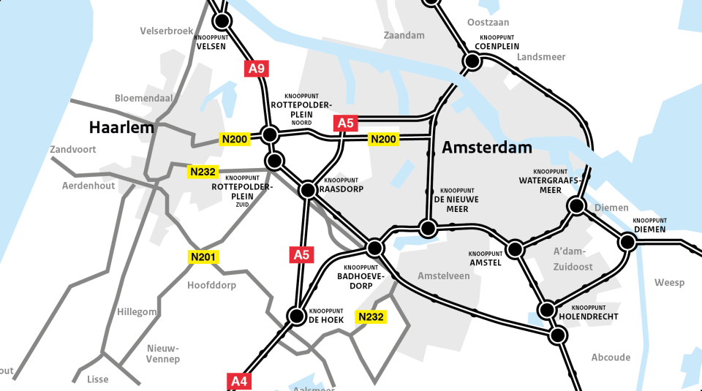

Testsite MRA

Slide 6
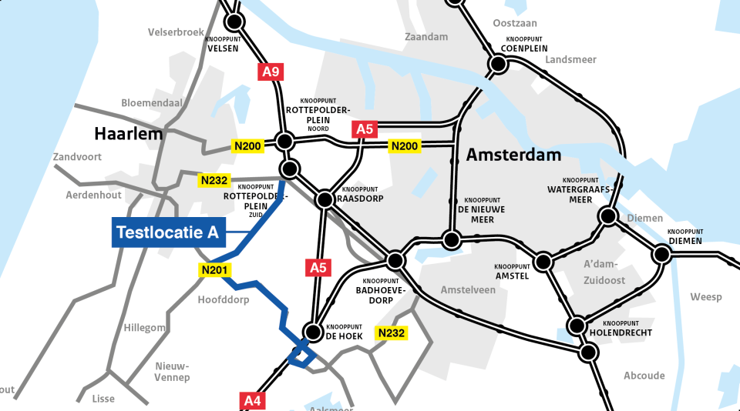
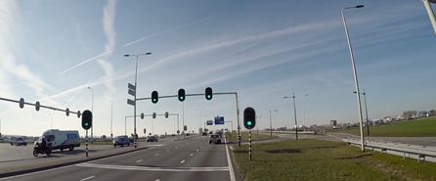
Location Interurban (Province)

Slide 7
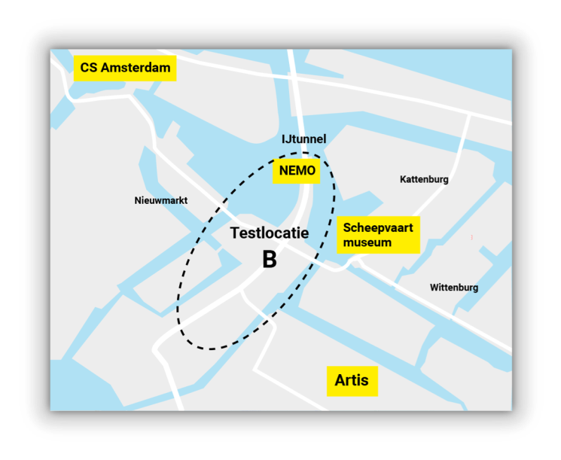
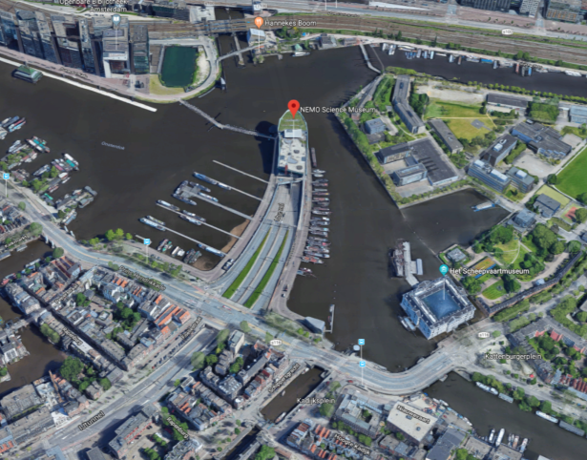
Location Urban (City of Amsterdam)

Slide 8
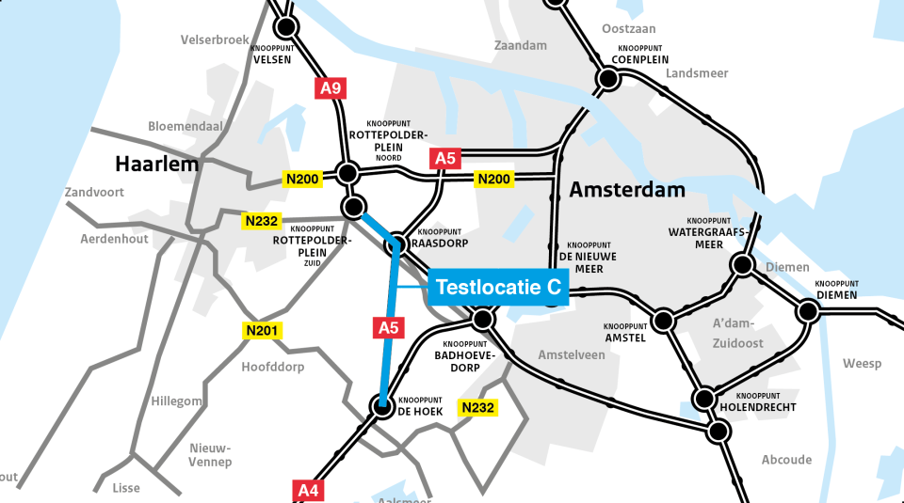
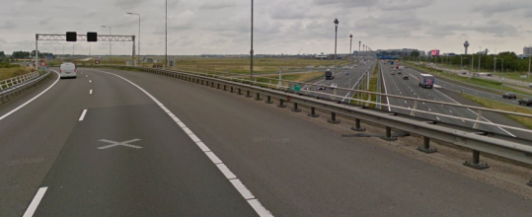

Location Highways

Slide 9
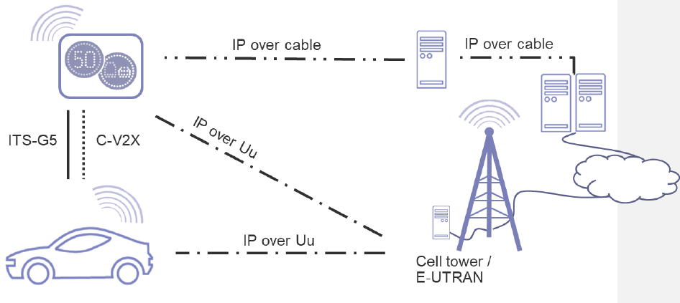
High Level Pilot Overview

