Slide 1
Urban Air Mobility in Madrid
ERTICO City Moonshot
February 23rd, 2024

Slide 2
Madrid: 3.3 million inhabitants and 6.8 million at a regional level. 21 districts (128 neighborhoods).
Second most populated Functional Urban area in the European Union.
Key role in the country´s economy (12% of total GDP).
Belonging to 2 TEN-T corridors.

Slide 3
The three Madrid 360 transformation vectors (City, Mobility and Administration) aim to transform Madrid into a more sustainable city from the environmental, social, and economic point of view. Those vectors are developed within the following strategic scopes.
City
Mobility
Administration
Electrification
New infrastructures
Public transport promotion
Multimodal integration and innovation
Limitations for the more polluting vehicles
Renewal and improvement of the regulatory framework
Historical grants for infrastructure renewal
Circular economy and waste management
Green Infrastructures
To boost the bicycle use
Urban Goods Distribution(UGD)
Pedestrian areas
Energy efficiency and sustainability
Study and follow-up on the measures
Municipal Ordinance on Sustainable Mobility (2021): establishes the creation of an Urban Air Mobility Commission within 9 months after the adoption of EU law.

Slide 4
Madrid complies for the second time (2022 + 2023) with the Air Quality European Directive
Evolution of the NO₂ Annual Mean Values (2022 vs 2018)

Slide 5
Our mobility priorities for the next years
Mainstreaming zero-emission vehicles
Designing safe and inclusive streets and spaces
Guiding urban mobility innovation
Strengthen sustainable connections within and beyond cities
Promoting the concept of Mobility-as-a-Right

Slide 6
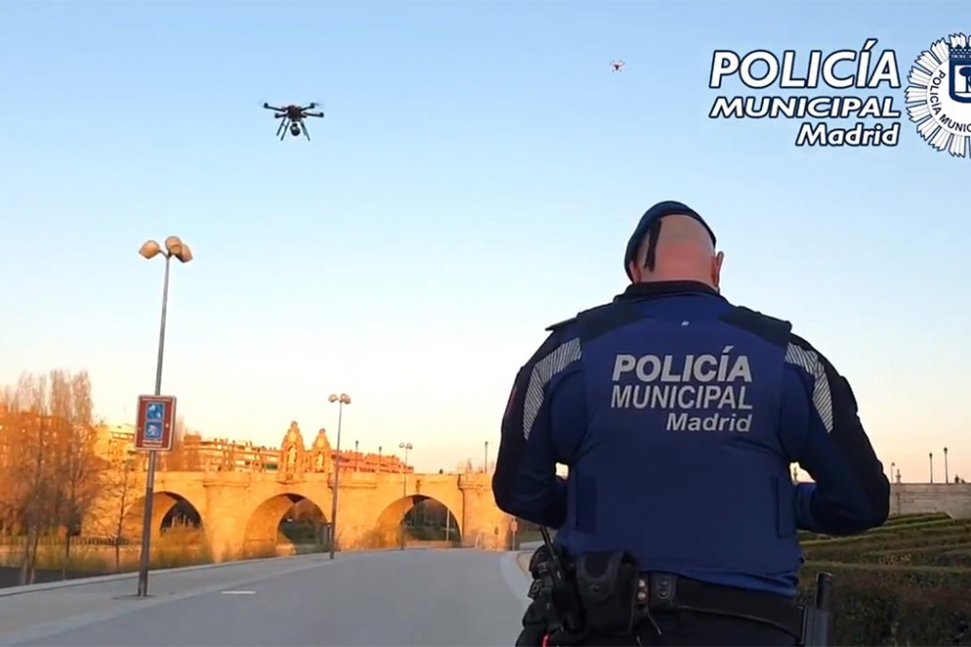
Use cases
Municipal police has been using drones for access control of festivals, illegal car races, etc. During the covid 19 pandemic when the Spanish population was confined to stay in their homes the police used drones for teh surveillance of public Parks.
Madrid City Council hosted the largest drone show ever organised in Spain. This celebration was held in honour of the Spanish National Day and featured a display of 300 aerial drones that lit up the sky over Casa de Campo lake last year on Friday 13 October at 21:00.

Slide 7
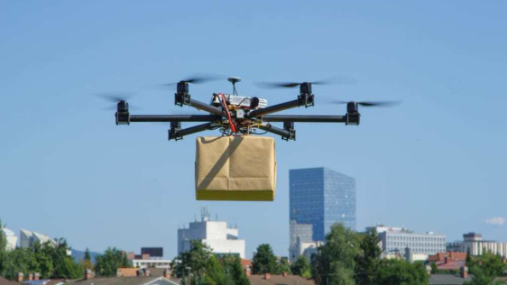
Pilot projects
In April 2021 we could see the first drones delivering in the district of Villaverde in a controlled mobility environment. For the moment, these are tests to carry out a study in which the rooftops will be the key, because of course the drone has to land to deliver the package.
It was one of the only trials in Spain that has two characteristics that make it different from the rest: one is that the drone moves with 5G - with a greater range than if it were using radio frequency - and the second is that the test had a real application. In this case, through a food order from a delivery company.
Madrid has consolidated its position as a pioneering city in the use of innovative technologies by successfully completing this drone pilot test in the Villaverde district. GesDron, a leading consultancy firm specialising in drones, carried out this initiative in collaboration with the City Council, setting an important precedent for urban air mobility.
https://www.theolivepress.es/spain-news/2021/03/23/europes-first-drone-delivery-service-to-be-launched-in-spains-capital-madrid/

Slide 8
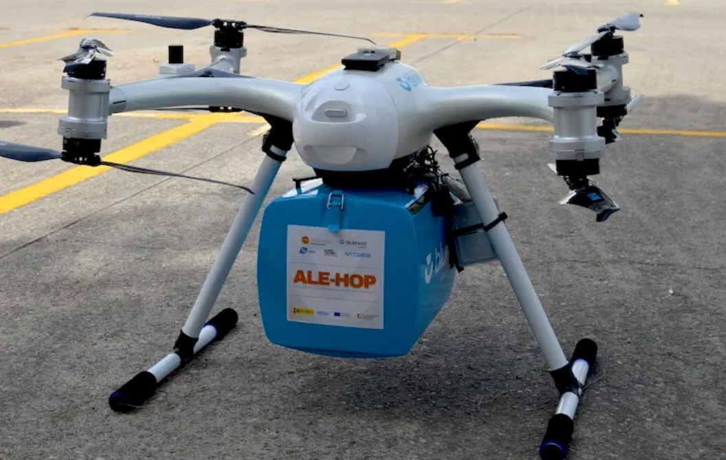
Pilot projects
ALE-HOP project in which the La Paz University Hospital participates, showing with a demonstration the viability of transporting medical supplies with drones between hospitals
The Ale-Hop project coordinated by Citet closed in July 2023 a first phase of tests to analyse the feasibility of using drones for the aerial transport of health material in urban environments.
In this first stage, key indicators have been obtained related to time savings, reliability of services, costs, logistics traceability and CO2 emissions.
A drone capable of carrying five kilos of cargo and equipped with eight motors was used for the tests. The device also has a range of 19 kilometres, with a flight time of 17 minutes and a maximum speed of 80 km/h.
With this first phase completed, the initiative is now focusing on a new phase that will involve the use of ticket offices for the reception and dispatch of cargo, as well as the design of emergency routes coordinated by AESA for automated flights, once it has been officially approved and has institutional funding.
https://www.citet.es/es/sala-de-prensa/ale-hop-la-paz-viabilidad-transporte-sanitario-drones-hospitales

Slide 9
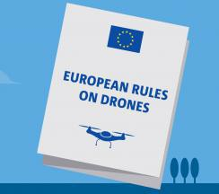
Challenges for Urban Air Mobility
National regulation (previously Real Decreto 1036/2017)
AESA (Agencia Estatal de Seguridad Aérea):
regulates aspects such as air transport, air navegation and airport security as well as drone use in Spain
Transitional period for the implementation of EU regulation (RE (UE) 2019/947 & RD (UE) 2019/945) coming to an end. Some new aspects entering into force starting from January 1st 2024
Classification of UAS, the obligation to maintain a direct line of sight and the electronic ID
Different licences, permits or similar certifications are required depending on the classification of the drone and category of the flight operation

Slide 10
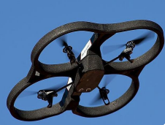
Challenges for Urban Air Mobility
Flight operation categories defined by national regulation in 2024:
Open category: The risk is very low, as they are transactions that do not require authorisation or prior notice. There are three sub-categories in this category: A1, A2 and A3.
Specific Category: In this category the risk is medium. These are operations that require an operational authorisation (which are operations under AESA authorisation) or operational declaration based on a standard scenario.
Certified Category: Higher risk category. These are operations that require certification of both the UAS and the operator, and a remote pilot licence.

Slide 11
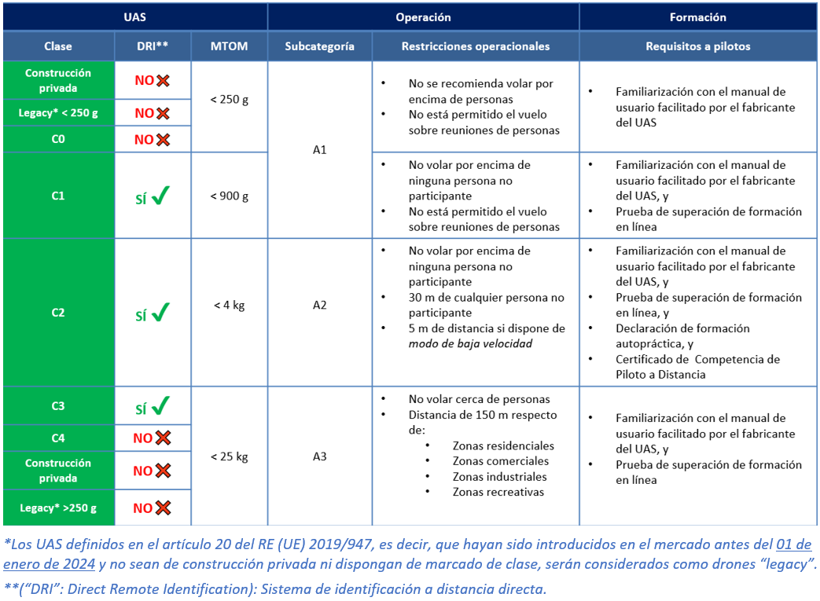
Challenges for Urban Air Mobility
Example of requirements and restrictions for operating different UAS according to their classifications and flight operations in open category as published by AESA
This table summarizes the new aspects introduced in the regulation in 2024. It helps operators understand the new regulation and impact on their operations

Slide 12
Challenges for Urban Air Mobility
General limitations for drone flight imposed by AESA
The drone, always within visual range of the pilot (except in specific category under STS BVLOS).
Never exceed 120 m altitude in flight.
Do not fly within 8 km of any airport, aerodrome or controlled airspace.
Liability insurance is compulsory. You must have an insurance policy that covers civil liability against third parties for damages that may be caused by a flight, whether recreational or professional. In Spain, it is also compulsory for drones weighing less than 250 grams.

Slide 13
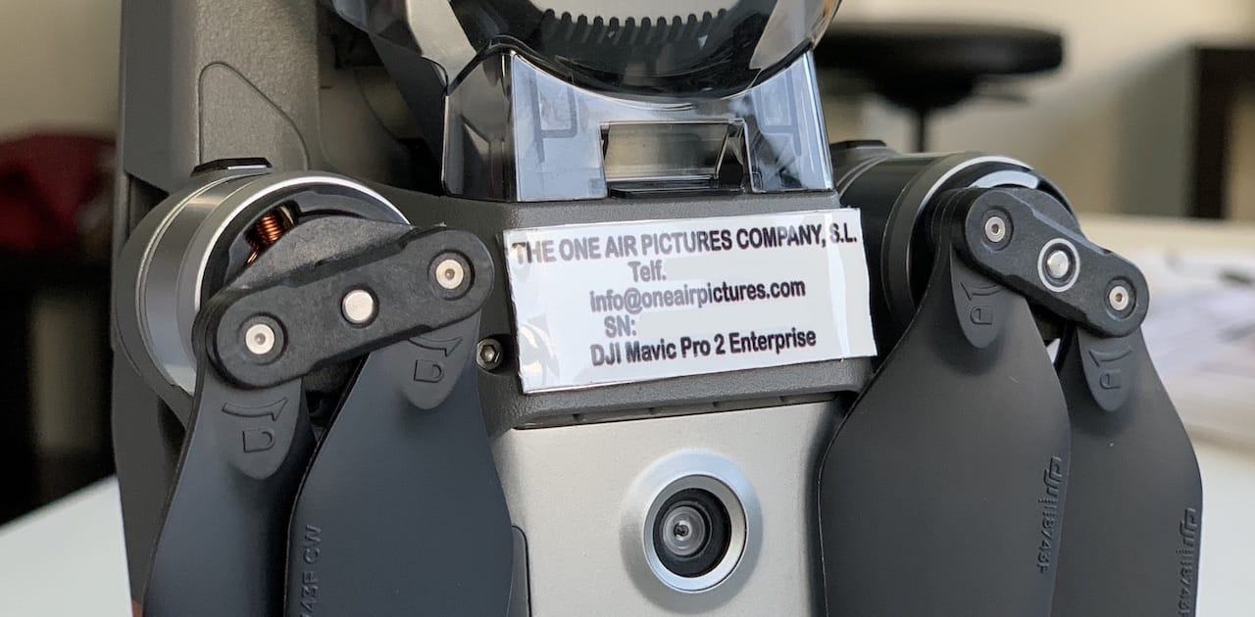
Challenges for Urban Air Mobility
General limitations for drone flight imposed by AESA
The drone must carry a fireproof identification plate attached to the structure containing data such as the manufacturer's name, model, serial number (if applicable) and the pilot's contact details.
Protect the right to privacy of individuals who may appear in the images captured by the drone and take special care with their public disclosure so as not to violate the Data Protection Act.

Slide 14
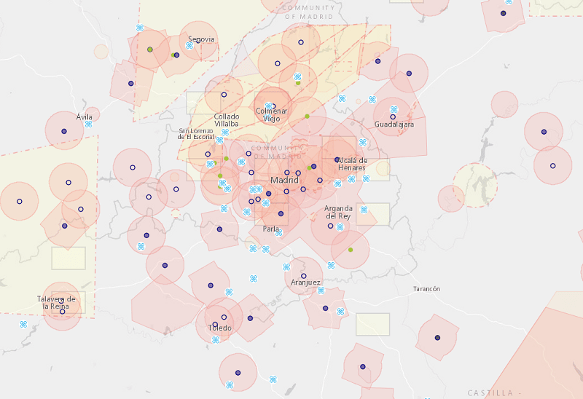
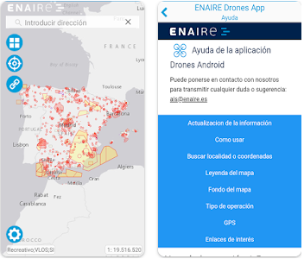
Challenges for Urban Air Mobility
Lack of clear and effective regulation of drones on local level
Air space regulation map Madrid
ENAIRE: controls Spanish air space to guarantee safe and secure flight operations

Slide 15
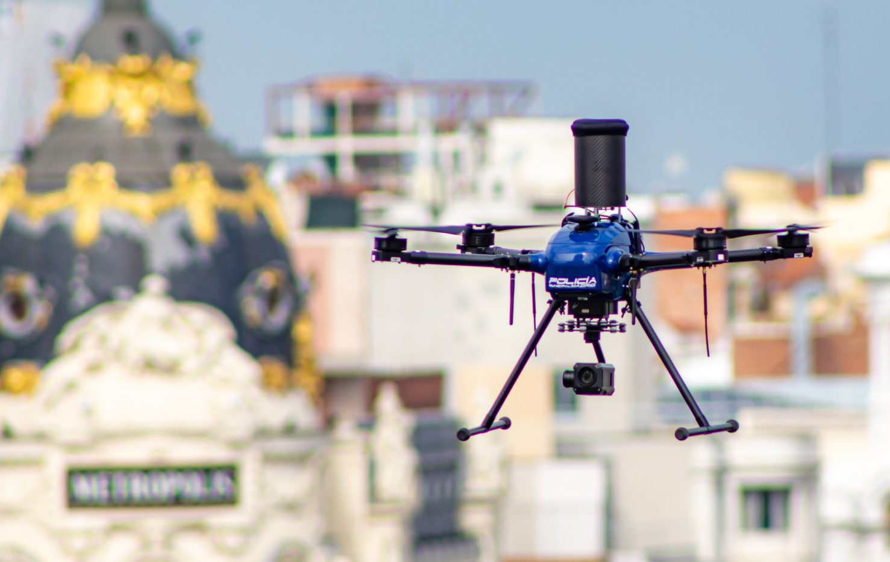
Challenges for Urban Air Mobility
Local regulation:
Lack of collaboration mechanisms for joint management of air space
Safety issues: drone use may lead to collisions with other aircrafts, buildings or persons
Privacy issues: drone use may lead to surveillance and illegal data collection
Development of unmanned air traffic management (UTM) systems and implementation of collision and conflict avoidance technologies.
Availability of adequate infrastructure, such as drone ports, charging stations and designated take-off and landing areas.
Training and certification for drone operators and the integration of drone operations management systems into urban planning and traffic management

Slide 16
Madrid City Council → Drones
Next Steps
Seek collaboration with EU-funded UAM projects (MUSE, MAIA, …) for more insight
Develop key performance indicators, methods and tools for the comprehensive and rigorous assessment of the impact of urban air mobility (UAM) operations on the quality of life in European cities (drone-generated noise, visual pollution, …).
Generate accurate drone 4D trajectories in urban areas, modelling UAM’s noise and visual footprints, high-resolution dynamic population mapping and calculation of population exposure indicators segmented by type of day and time of the day, citizens’ sociodemographic profile, type of activity being performed and other relevant variables.

Slide 17
Potential of Urban Air Mobility
The main advantage of Urban Air Mobility is the reduction in air and noise pollution in comparison with traditional mobility concepts and its indifference to typical problems such as traffic congestion
With the correct framework in place the City Council can promote innovation in this sector and facilitate the work of those companies that are already develpoing pilot projects for this new mobility
First step: creation of the Urban Air Mobility Commission in January 2024

Slide 18
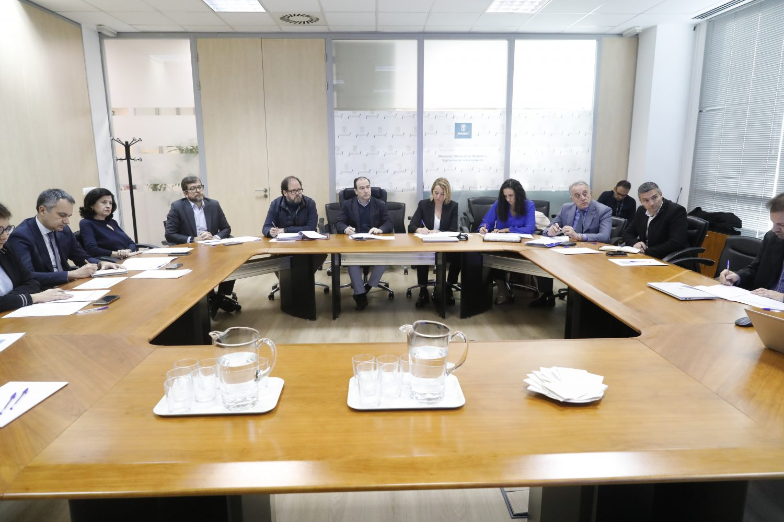
Potential of Urban Air Mobility
First step: creation of the Urban Air Mobility Commission in January 2024

Slide 19
Madrid Urban Air Mobility Commission
Presidente
Borja Carabante
Delegado
Vicepresidenta
María José Aparicio
Coordinadora
DG Planificación e Infraestructuras de Movilidad
DG Circulación
Policía Municipal
Ministerio de Transportes, Movilidad y Agenda Urbana
Ministerio del Interior
Ministerio de Defensa
Agencia Estatal de Seguridad Aérea
Comunidad de Madrid
Composition
The UAM Commission works as a operational body to guide and advise the City Council on its endevour to establish a regulatory framework for safe and sustainability Urban Air Mobility. The Commission meets every 6 months.

Slide 20
Madrid Urban Air Mobility Commission
Responsibilities
Research the conditions governing the urban aerial mobility of remotely piloted aircraft (drones) within the framework of the EU, national and, where appropriate, regional regulations that are enacted on the operations of these systems.
Collaboration with competent entities for the creation of U-Space
Study the integration of Urban Air Mobility into the existing mobility models.
Topics to be considered other than regulation:
Security and control (Local Police)
Physical infrastructures such as landing zones, charging points, etc. (DG Planificación)
Technological infrastructures to define UAM space such as secure routes (Agentes del Sector)

Slide 21
Madrid Urban Air Mobility Commission
Next Steps
Creation of working groups to study the UAM phenomenon and prepare a specific proposal of actions to take and measures to implement
Regulation
Objectives: Analysis of existing regulations and their impact on local regulations; Definition of legal requirements and authorization procedures for activities related to UAM activities; Drafting of regulatory and management proposals; Communication with the rest of the administrations; Internal training in Madrid City Council.
Security
Objectives: Definition of flight safety requirements; Definition of exclusion zones; Definition of protocols for dealing with security breaches, etc.
Operations
Objectives: Definition of operational requirements; Liaison with air navigation providers; Definition of safety and emergency operational procedures in the event of incidents.

Slide 22
Madrid Urban Air Mobility Commission
Infrastructure
Objectives: analysis of UAM infrastructures from an urban planning and safety point of view; analysis of procedures for setting up infrastructures for different needs; analysis of use of drones (landing/clearance) in buildings and public spaces.
Environment & Citizens
Objectives: analysis of environmental requirements of drone infrastructure and operation; study the preparedness for the implementation of UAM services in the city and their acceptance by citizens; definition of models of interaction with citizens: channels, content, incident management, public communication, etc.
Private Sector Stakeholders
Objectives: Analysis of proposals from economic agents in the field of air mobility; Identification of areas and projects of interest; Development of pilot projects. E.g. Bluenest (Openvia). Transport of medical samples between Hospital Ramón y Cajal and Carlos III.

Slide 23
Madrid Urban Air Mobility Commission
Urban Air Mobility Commission working groups
1. Regulatory Working Group
Objectives: Analyze existing regulations – European, national and regional – and their impact on local regulations; Definition of the legal requirements and authorization procedures for activities linked to urban air mobility activities (authorizations, fees, etc.;
2. Security Working Group).
Objectives: Definition of flight safety requirements; Definition of exclusion zones; Definition of action protocols in the event of security breaches;
3. Operation working group
Objective: Definition of operational requirements; Interlocution with air navigation providers; Definition of security and emergency operating procedures in the event of incidents.
4. Infrastructure Working Group
Objective: Analyze the deployment of urban air mobility infrastructure from an urban planning and security point of view; Analyze the procedures for establishing infrastructure for different needs (passenger transportation, merchandise transportation);
5. Environment and citizenship working group
Objective: Analyze the environmental requirements (noise, emissions, electrical load, etc.) of drone infrastructure and operation; Carry out the necessary studies for the implementation of air mobility services in the city and their acceptance by citizens (privacy, noise, security, etc.); Objective: Analysis of proposals from economic agents regarding air mobility; Determination of areas and projects of interest; Development of pilot projects. Eg. Bluenest (Openvia). Transport of medical samples between Hospital Ramón y Cajal and Carlos III

Slide 24
Thank you very much
Pedro Fernandez
Jefe de Departamento
dgplaniymovi@madrid.es
Dirección General de Planificación e Infraestructuras de Movilidad
Coordinación de Movilidad
A.G. Urbanismo, Medio Ambiente y Movilidad
Ayuntamiento de Madrid
Madrid City Council

